Slide 1
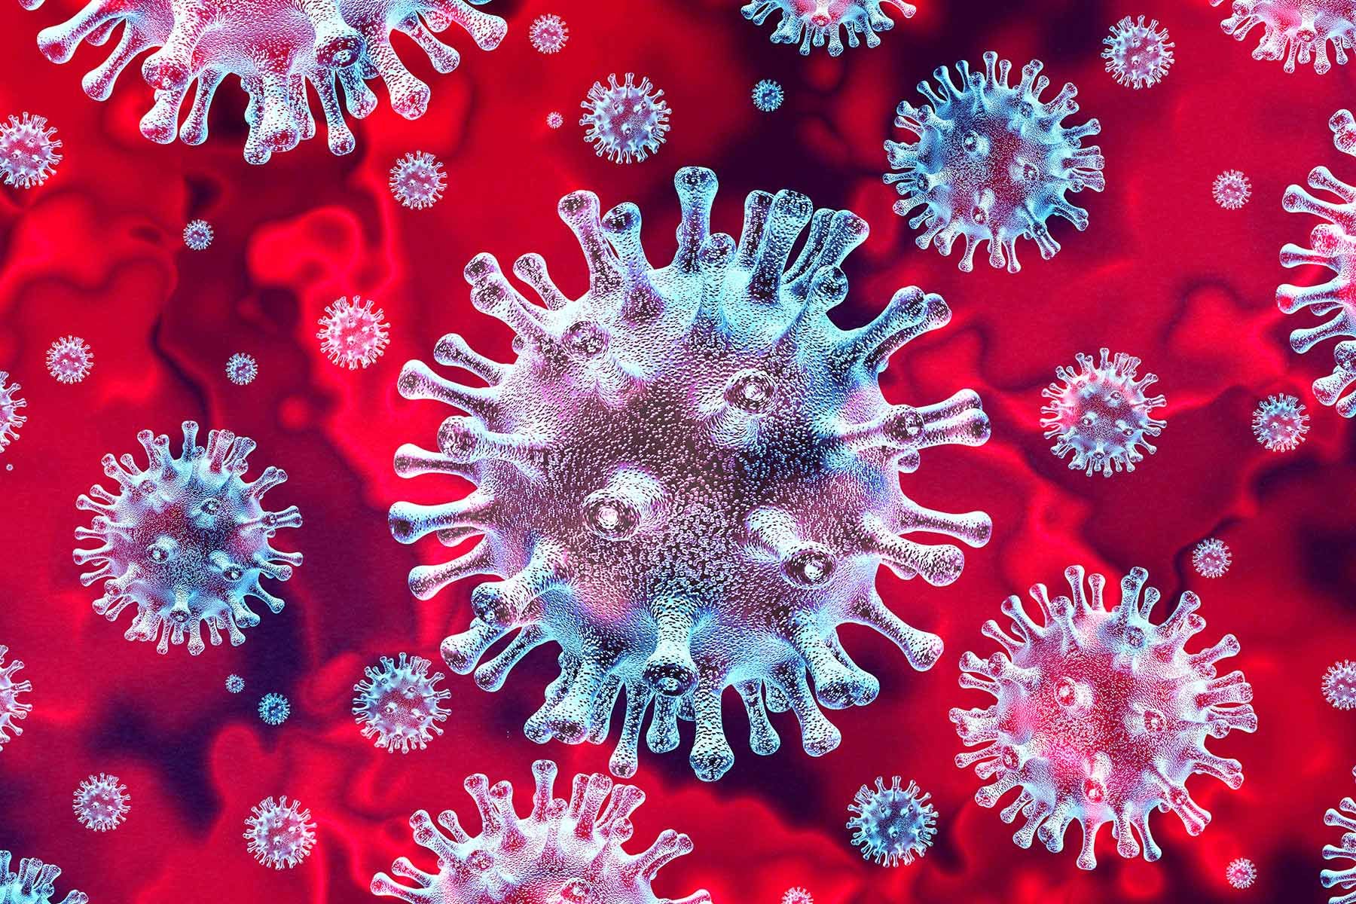
Saint Peter’s
COVID-19
Nursing Care Guidelines

Slide 2
Saint Peter’s
COVID-19
Nursing Care Guidelines
Learning Outcome: All participants that complete this online module will demonstrate
enhanced/reinforced knowledge related to COVID-19 self monitoring, health care worker protection and care of the COVID-19 patient evident through a 100% passing grade on a post-test.

Slide 3
SELF-MONITORING
To protect patients and co-workers, Saint Peter’s employees, residents and providers are responsible to self-monitor for symptoms as well as temperature checks each day for signs of possible COVID-19 infection before being allowed to proceed to work areas.
Employees, residents and providers should not enter any health system facility with signs and symptoms of any illness, including COVID-19.
Self-monitoring includes monitoring for symptoms of illness, including COVID-19 including: fever at or above 99.6 degrees Fahrenheit, chills, cough, shortness of breath or difficulty breathing, fatigue, muscle or body aches, headache, new loss of taste or smell, congestion or runny nose, nausea or vomiting or diarrhea.
PREVENTION OF EXPOSURE
Universal masking of all staff/team members went into effect on March 22, 2020 and remains in effect.
Masks are required for all others entering the building regardless of nature of visit.
Universal goggles/eye face shields (not eyeglasses) went into effect for all team members/staff/LIPs on March 30, 2020 and remains in effect.
Eye protection is to be worn for all patient contact within 6 feet or less.
Continuously educate patient/family to put their mask on upon SPUH staff entry into patient room

Slide 4
Masking Guidelines
SURGICAL MASKS | N95 MASKS
Universal Masking: SPUH will provide a surgical mask to all employees for daily use. All patients will be provided a surgical mask. The Health Care Worker (HCW) will ask the patient to put on their mask (if capable, or they will assist the patient) prior to entering the patient's room. SURGICAL MASKS AND GOGGLES Patient care for all non-COVID, PUI and COVID + patients. | N95 Masks: N95 Masks covered by a surgical mask will be worn by HCW when entering the room of a PUI or COVID positive patient that requires airborne precautions (i.e. those undergoing Aerosol-generating Procedures, Intubation, extubation, CPR, Open Suctioning, High Flow Oxygen, Chest PT, nasopharyngeal specimen collection). The surgical mask should be discarded after each patient interaction and the HCW may continue to wear their N95. Or Discard the surgical mask, remove their N95 and don a new surgical mask.
Surgical Masks: Surgical Masks are to be used when caring for PUIs and COVID+ patients that are NOT undergoing Aerosol generating procedures (Intubation, extubation, CPR, Open Suctioning, High Flow Oxygen, Chest PT, nasopharyngeal specimen collection). | N95 Masks: N95 masks will be worn by the OR team during surgery for PUI or COVID + patients (including C- sections).
Surgical Masks: Surgical Masks are to be worn by all patients including PUI and COVID+ patients during transport. (Masks are worn by HCWs and patients). Surgical masks are being provided to all patients and staff, as well as support persons accompanying patients. | N95 Masks: N95 masks will be worn in Procedural areas performing aerosol-generating procedures for COVID + or PUI ( Intubation, extubation, CPR, Open Suctioning, High Flow Oxygen, Chest PT, nasopharyngeal specimen collection and during second stage of labor.) Daily N95 Mask Decontamination with Xenex Robot up to 5 times is available. SPUH cannot guarantee effectiveness of reprocessing if not a Saint Peter's issued mask. N95 respirators are to be covered with a surgical mask and changed between each patient. N95 respirators are provided to required areas/healthcare workers
*N95 Mask: SPUH will permit but is not responsible for the safety of the mask (proper fit test) or correct manufacturer brought in from the outside.

Slide 5
Nursing Assessment
Careful assessment is essential in the evaluation and management of patients who may have COVID-19, and particularly in those with fever, acute respiratory illness, and other symptoms of infection.
Physical examination – careful documentation of the patient’s signs and symptoms, which may develop 2 to 14 days after exposure to the virus; the Centers for Disease Control and Prevention (CDC) lists the following symptoms of COVID-19:
Fever, chills
Cough
Dyspnea
Headache
Fatigue
Myalgia
Sore throat
New loss of smell (anosmia) or taste (ageusia)
Congestion or runny nose
Nausea or vomiting
Diarrhea
Not every patient with COVID-19 experiences all these symptoms.
https://journals.plos.org/plosone/article?id=10.1371/journal.pone.0234765
From AACN: Evidence-Based Early Recognition and Management of ARDS Drives Outcomes: The Why and How
https://www.aacn.org/education/ce-activities/nti18347/evidencebased-early-recognition-and-management-of-ards-drives-outcomes-the-why-and-how

Slide 6
Specimen Collection Guidelines For 2020-2021 Respiratory Season
All patients for admission will have a COVID 19 test performed as per SPUH COVID-19 Guidelines.
When multiple tests are ordered, the order for specimen collection is as follows:
1. Perform nasopharyngeal swab for Covid-19 (& RVCR – respiratory viral panel if ordered) first.
2. Perform nasal wash second if flu testing or RSV is ordered.
3. Staff must wear appropriate PPE during specimen collection
(N95 respirator, covered by a surgical mask, gown, gloves, eye protection).
All COVID specimens MUST be double bagged individually.
Only 1 specimen per double bag.
Lab Order Requisition slip MUST be adhered to the outside of the double bag, NOT placed in the bag.
Reference:
Interim Guidelines for Collecting, Handling, and Testing Clinical Specimens from Persons for Coronavirus Disease 2019 (COVID-19) https://www.cdc.gov/coronavirus/2019-ncov/lab/guidelines-clinical-specimens.html

Slide 7
Nursing Diagnosis
A nursing diagnosis provides clinical judgment about the patient’s experiences and responses to potential coronavirus infection. Nursing diagnosis for a patient with COVID-19 can include:
Possible exposure to the virus that causes COVID-19
The patient’s level of knowledge about the transmission of COVID-19
Fever
Infection
Impaired breathing pattern related to shortness of breath
Impaired Oxygenation
Impaired Psychosocial Being
Anxiety associated with the unknown etiology of the disease

Slide 8
Nurse Care Planning and Goals
Establishing nursing care plan goals can help improve patient outcomes and decrease the transmission of COVID-19. Major nursing care planning goals for COVID-19 may include:
Establishing goals, interventions
Assessing altered skin integrity risks, fatigue, impaired comfort, gas exchange, nutritional needs, and nausea
Preventing the spread of coronavirus infection to the patient’s family members, community, and healthcare providers
Reducing fever
Restoring normal respiratory patterns
Easing anxiety, which is relatively common in COVID-19 patients, with a combination of anxiolytic medications and therapy that includes relaxation techniques, breathing exercises and encouragement

Slide 9
Nursing Interventions
Based on assessment data, nursing interventions for COVID-19 should focus on monitoring vital signs, maintaining respiratory function, managing hyperthermia, and reducing transmission.
Monitor vital signs – particularly temperature and respiratory rate, as fever and dyspnea are common symptoms of COVID-19.
Monitor O2 saturation – normal O2 saturation as measured with pulse oximeter should be 94 or higher; patients with severe COVID-19 symptoms can develop hypoxia, with values dropping low enough to warrant supplemental oxygen. Consider proning if not medically contraindicated.
Manage fever – use appropriate therapy for hyperthermia, including adjusting room temperature, eliminating excess clothing and covers, using cooling mattresses, applying cold packs to major blood vessels, starting or increasing intravenous (IV) fluids as allowed, administering antipyretic medications as prescribed, and readying oxygen therapy in the event of respiratory problems resulting from the metabolic demands for oxygen during a fever.
Maintain respiratory isolation – isolation rooms should be well-marked with limited access; all who enter the restricted-access room should use personal protective equipment, such as masks and gowns.
Enforce strict hand hygiene – to reduce or prevent transmission of coronavirus, patients should wash hands after coughing, as should all who enter or leave the room.
Provide information – educate the patient and patient’s family members of the transmission of COVID-19, the tests to diagnose the disease, disease process, possible complications, benefits of prone position and ways to protect oneself and one’s family from coronavirus. Continuously educate patient/family to put their mask on upon SPUH staff entry into patient room

Slide 10
Prone Positioning for Non-Intubated Patients Guideline
Designated Clinical Areas: All in-patient areas caring for COVID-19
Introduction/Purpose:
For patients with hypoxemia, there are many physiologic benefits to the prone, as opposed to the supine, position. These include better matching of pulmonary perfusion to ventilation, better recruitment of dependent areas of the lung and improved arterial oxygenation.
In addition, there is evidence that the prone position results in a more homogenous distribution of stresses in the lung and thus may prevent patients with hypoxemia from developing frank respiratory failure. Prone positioning is extensively used in the ICU to treat intubated patients with hypoxemic respiratory failure, but the benefits cited above should accrue to non-intubated patients as well.
For this reason, patients admitted with hypoxemia should be encouraged to adopt the prone position where practical and prone positioning may be used as a rescue therapy in patients with escalating oxygen needs. This document serves to inform clinicians about prone positioning of non-intubated, hypoxemic patients.
Contraindications:
Spinal instability
Facial or pelvic fractures
Open chest or unstable chest wall
Relative contraindications: delirium, confusion, inability to independently change position, recent nausea or vomiting, advanced pregnancy
Equipment:
Pillow
Supplemental oxygen, as needed
Foam Dressings to protect pressure points (if indicated)
Continuous O2 monitor
From AACN: Why Prone? Why Now? Improving Outcomes for ARDS Patients
https://www.aacn.org/education/webinar-series/wb0042/why-prone-why-now-improving-outcomes-for-ards-patients

Slide 13
Educate your patients on the importance of the PRONE position

Slide 14
Evaluation
Evaluation helps nurses determine if they have met their goals.
Evidence for meeting nursing goals for COVID-19 might include:
The patient successfully prevented the spread of infection to family, the community, or to healthcare staff
The patient learned more about COVID-19 and its management
The patient had improved body temperature levels
Restoration to normal breathing patterns
Normal Oxygenation
Reduced anxiety

Slide 15
Documentation Guidelines
Documentation is always important, Documentation guidelines for COVID-19 patients include:
Individual assessment/ reassessment findings, including any external factors affecting the patient’s illness, interactions, nature of social exchanges, and specifics patient behaviors
Cultural and religious beliefs expressed by the patient
Patient expectations
Care plan
Teaching plan
Responses to nursing interventions, education, and information, and nursing actions performed
Attainment of, or progress toward, the desired clinical outcome and fulfillment of patient expectations

Slide 16
Specific Paragon Documentation Points
Remember to enter the COVID alerts and Isolation Statuses
Emergency Department Questions

Slide 17
Communication with Family and Caregivers
Establish scheduled times for communication with family/caregivers:
Communication should be for medical updates as well connecting the patients and families
Facetime for family/caregiver communication
Phone calls

Slide 18
Other Nursing Care Considerations
Standardizing/consolidating times for medication administration
Cluster care to minimize time in room in order to reduce risk of exposure
Avoid nebulized medications in COVID 19 patients
ECG monitoring protocol for hydroxychloroquine & azithromycin
IV pumps outside the patient room
Extended IV tubing ( extension sets or MRI tubing) & medications that should not be given via extended tubing i.e.. insulin.
Patient barcode on IV pole for safe BCMA
Line reconciliation per policy
Establish proning teams, see proning guidelines
Facetime for family/caregiver communication
For safety concerns consider utilizing camera for continued observation

Slide 19
Medications, listed in red, are no longer clinically relevant at SPUH

Slide 21
Questions
To protect patients and co-workers, Saint Peter’s employees, residents and providers are responsible to self-monitor for symptoms as well as temperature checks each day for signs of possible COVID-19 infection. Self-monitoring includes monitoring for symptoms of illness, including COVID-19 including: fever at or above 99.6 degrees Fahrenheit, chills, cough, shortness of breath or difficulty breathing, fatigue, muscle or body aches, headache, new loss of taste or smell, congestion or runny nose, nausea or vomiting or diarrhea. True or False
Universal masking of all staff/team members went into effect on March 22, 2020 and remains in effect. Universal goggles/eye face shields (not eyeglasses) went into effect for all team members/staff/LIPs on March 30, 2020 and remains in effect. Eye protection is to be worn for all patient contact within 6 feet or less. True or False
N95 masks will be worn in all areas performing aerosol-generating procedures for COVID + or PUI. Aerosol-generating procedures include:
Intubation
Extubation
CPR
Open Suctioning
High Flow Oxygen
Chest PT
Nasopharyngeal specimen collection
During second stage of labor
a, d, e and f
All of the above

Slide 22
4. When multiple tests are ordered, there is an order of collection for specimens.
a. Perform nasopharyngeal swab for Covid-19 (& RVCR – respiratory viral panel if ordered) first. Perform nasal wash second if flu testing or RSV is ordered.
b. Perform nasal wash if flu testing or RSV is ordered. Than perform nasopharyngeal swab for Covid-19 (& RVCR – respiratory viral panel if ordered).
5. All COVID specimens MUST be double bagged individually. Only 1 specimen per double bag. Lab Order Requisition slip MUST be adhered to the outside of the double bag, NOT placed in the bag. True or False
6. Establishing nursing care plan goals can help improve patient outcomes and decrease the transmission of COVID-19. Major nursing care planning goals for COVID-19 may include:
Assessing altered skin integrity risks, fatigue, impaired comfort, gas exchange, nutritional needs, and nausea
Preventing the spread of coronavirus infection to the patient’s family members, community, and healthcare providers
Reducing fever
Restoring normal respiratory patterns
Easing anxiety, which is relatively common in COVID-19 patients
All of the above

Slide 23
7. Educate the patient and patient’s family members. Education must include information about
The transmission of COVID-19
The SPUH bed placement policy
The tests to diagnose the disease
The disease process and possible complications
The benefits of prone position
The necessity for patient to put their mask on upon SPUH staff entry into patient room
All of the above
a, c, d ,e, and f
8. For patients with hypoxemia, there are many physiologic benefits to the prone, as opposed to the supine, position. These include better matching of pulmonary perfusion to ventilation, better recruitment of dependent areas of the lung and improved arterial oxygenation.
True or False
9. If you have a patient there are Paragon alerts that should be documented upon if applicable. They are
COVID- History of COVID
COVID- No visitors alert
Isolation Status Alert for COVID
a, b
a, c
All of the above

Slide 24
10. There are many important nursing considerations when caring for COVID patients. Some of them include:
IV pumps outside the patient room
Extended IV tubing ( extension sets or MRI tubing)
Some medications that should not be given via extended tubing i.e.. insulin.
Patient barcode on IV pole for safe BCMA
Line reconciliation per policy
Scheduled phone calls or Facetime for family/caregiver communication and medical updates
All of the above
11. There are many therapeutic pharmacologic agents that are administered to COVID-19 patients depending on symptoms to patients at SPUH. Some of them include.
Remdesivir as an anti-viral agent.
Tocilizumad to reverse cytokine storm
Dexamethasone to decrease inflammation
All of the above

